Slide 1


Global Road Accident Trends & Insights
Visualizing Data to Understand Causes, Impacts, and Safety Measures

Slide 2

The Global Impact of Road Accidents
Road accidents are a leading cause of death and injury worldwide.
They result in millions of fatalities and economic losses annually.
Understanding accident patterns is crucial for improving road safety policies.

Slide 3

Why Analyze Road Accident Data?
To identify trends and risk factors contributing to accidents globally.
To highlight critical insights for reducing accidents and fatalities.
To support data-driven decisions for road safety improvements.

Slide 4
Exploring the Global Road Accident Dataset
Global Accidents
Countries (USA, UK, India, China, Canada, and Japan, …)
Driver Information (Age, gender, alcohol level, fatigue)
Accident Details (Severity, cause, injuries, fatalities)
Environmental Factors (Weather, road conditions, time of day)
Global Coverage: Accident records from diverse regions including the USA, UK, India, China, Canada, and Japan.
Comprehensive Variables:
🚗 Driver Profile: Age groups, gender, alcohol consumption, fatigue levels.
⚠️ Accident Metrics: Severity levels, causes, number of injuries, fatalities.
🌍 Environmental Factors: Weather conditions, road types, urban vs. rural settings, time of day.
Analytical Approach: Leveraging Excel for data exploration, trend analysis, and interactive dashboard creation.

Slide 5

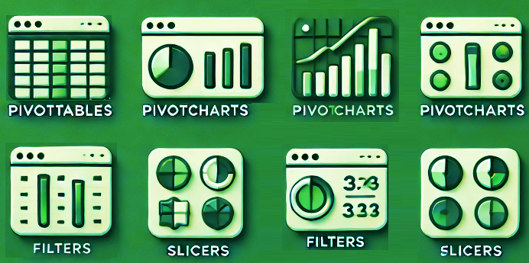

Analyzing Data with Excel
Data Cleaning: Ensuring accuracy and consistency.
PivotTables & Charts: For summarizing large datasets.
Slicers & Filters: To create interactive dashboards.
Conditional Formatting: For highlighting key trends.

Slide 6

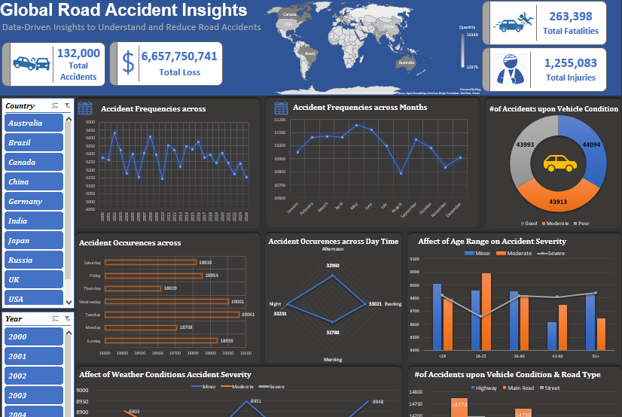
A Glimpse of the Interactive Dashboard
key features:
Dynamic charts
Slicers for filtering by region, time, etc.
KPIs for quick insights (accident rates, fatalities, etc.)

Slide 7
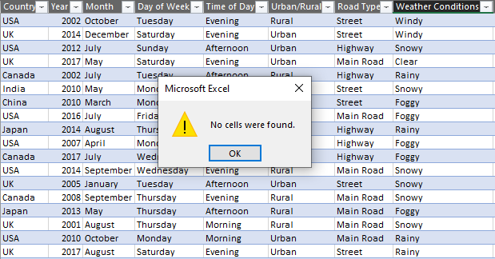
Data Cleaning Detecting Missing Data
No missing data found in the dataset.

Slide 8
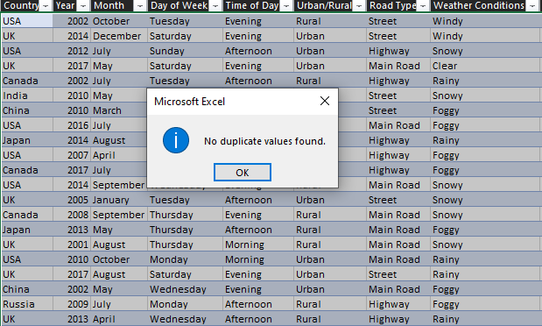
Data Cleaning Detecting Duplicated Data
No duplicated data found in the dataset.

Slide 9
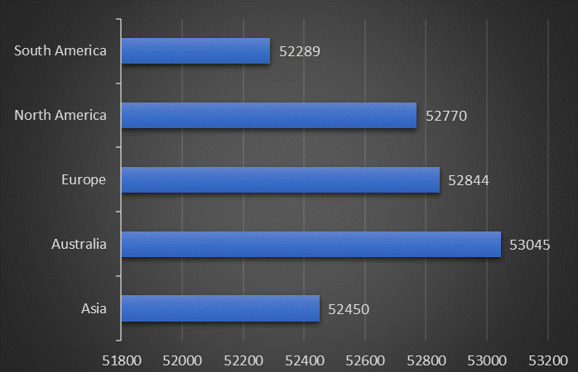
Data Visualization Measuring the Impact of Road Accidents
Fatalities per Region 🌍

Slide 10
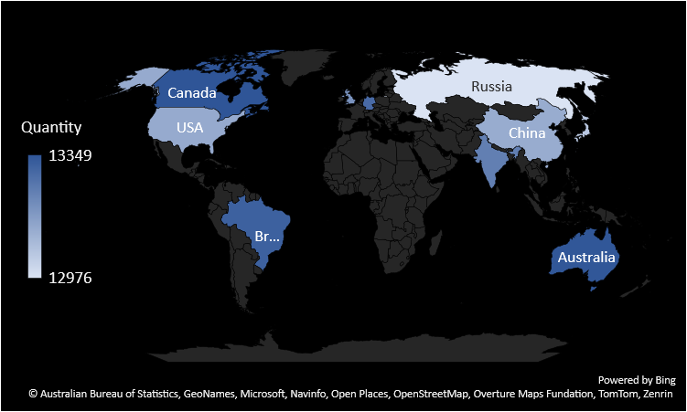
Data Visualization Measuring the Impact of Road Accidents
Accident rate per Country 🌍

Slide 11
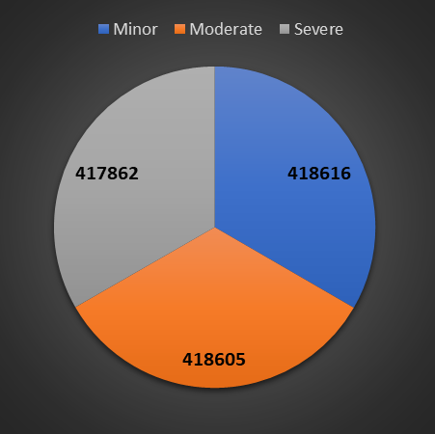
Data Visualization Measuring the Impact of Road Accidents
Injury Rates by Accident Severity 🚑

Slide 12
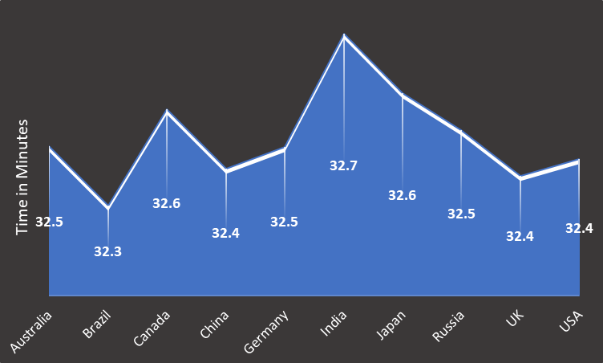
Data Visualization Measuring the Impact of Road Accidents
Response Time Analysis: How long was the average emergency response times for each country? 🚓

Slide 13
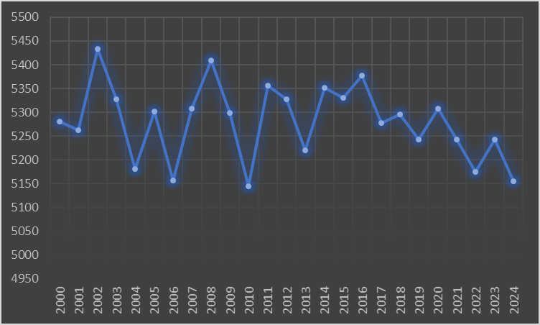
Data Visualization How Have Road Accidents Evolved?
Yearly Accident Trends 📊

Slide 14
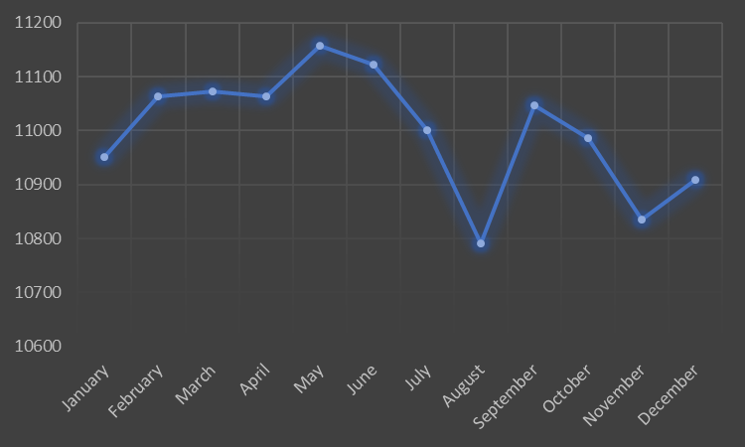
Data Visualization How Have Road Accidents Evolved?
Monthly Patterns: Which months show higher accident rates? 📆

Slide 15
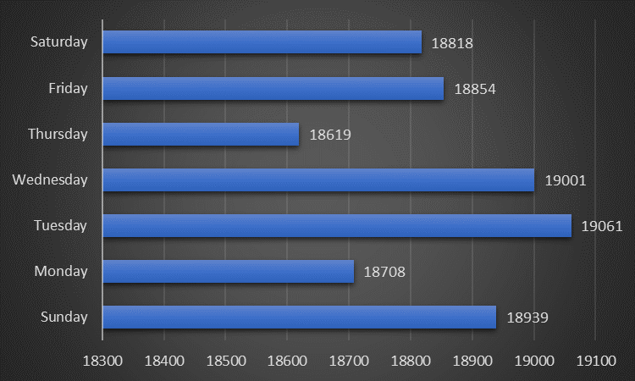
Data Visualization How Have Road Accidents Evolved?
Day of the Week Analysis: Which days are riskier? 📅

Slide 16
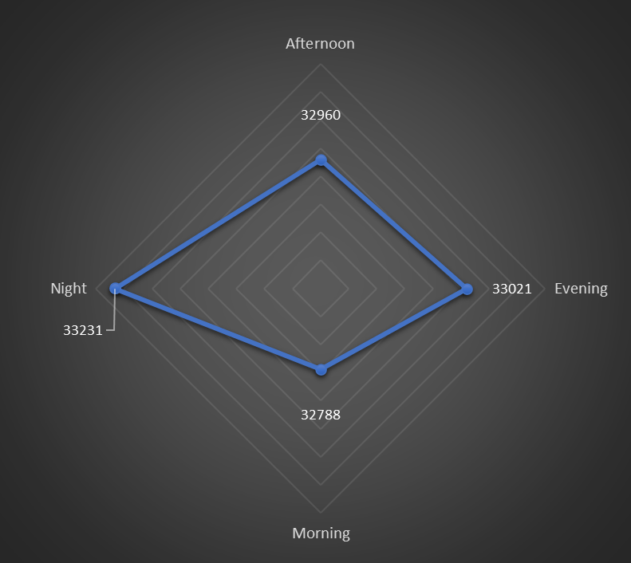
Data Visualization How Have Road Accidents Evolved?
Time of Day Analysis: When Are Accident Rates Higher across the day? ⏱️

Slide 17
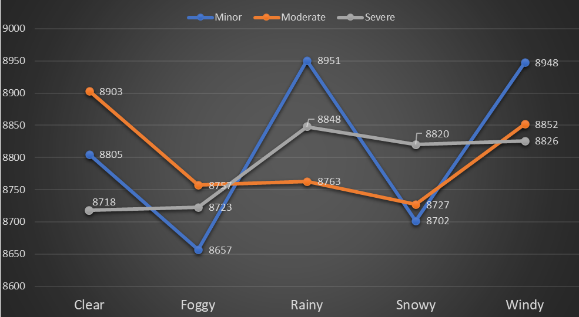
Data Visualization Weather, Road Conditions, and Accident Severity
Accidents under rainy, snowy, foggy conditions 🌧️❄️🌫️

Slide 18
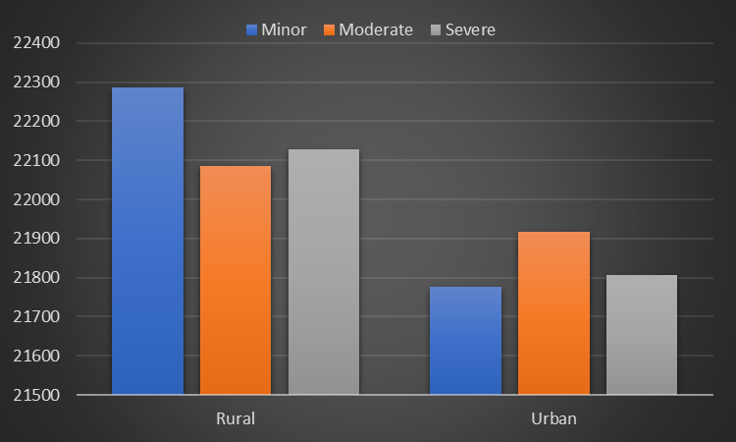
Data Visualization Weather, Road Conditions, and Accident Severity
Urban vs. Rural accident rates 🌆🏞️

Slide 19
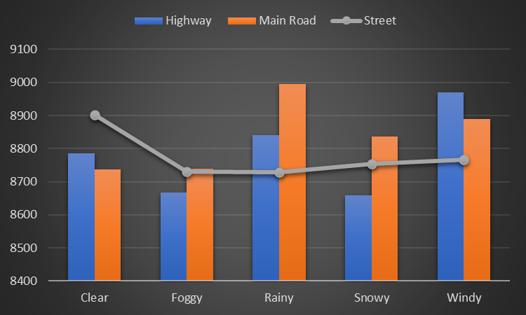
Data Visualization Weather, Road Conditions, and Accident Severity
Road Types: Streets, highways, main roads—where are accidents most severe? 🛣️

Slide 20
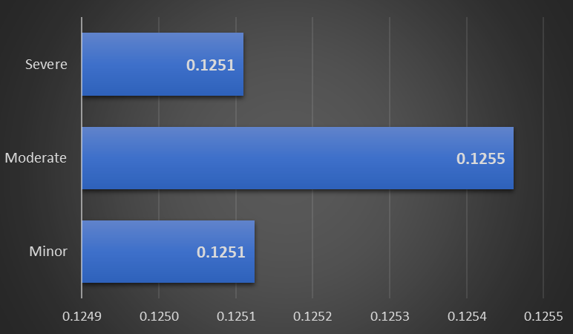
Data Visualization The Role of Driver Behavior in Accidents
Alcohol Influence: Accident severity vs. alcohol levels 🍺

Slide 21
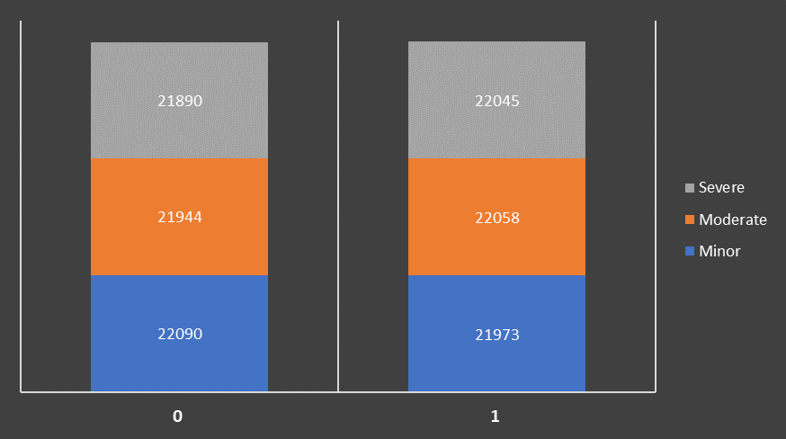
Data Visualization The Role of Driver Behavior in Accidents
Driver Fatigue Patterns: How fatigue contributes to accident risks 😴

Slide 22
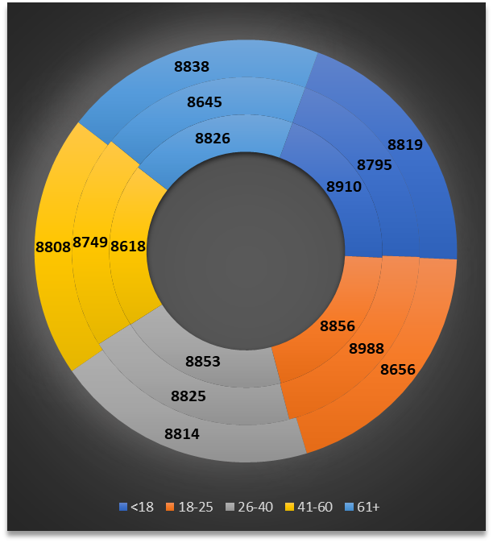
Data Visualization The Role of Driver Behavior in Accidents
Age Distribution: Are certain age groups more at risk? 👥

Slide 23
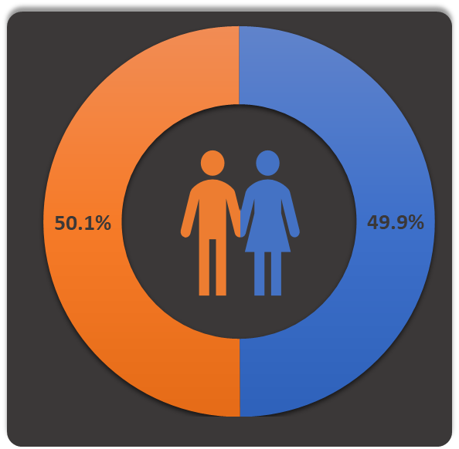
Data Visualization The Role of Driver Behavior in Accidents
Gender Distribution: Does a specific driver gender have a higher accident frequency? 👥

Slide 24
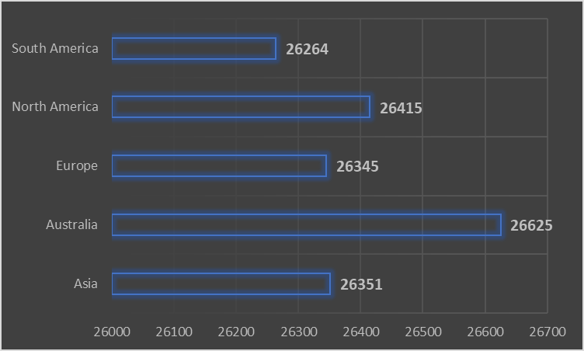
Data Visualization Road Accidents Across the Globe
Accident rates by region 🌍

Slide 25
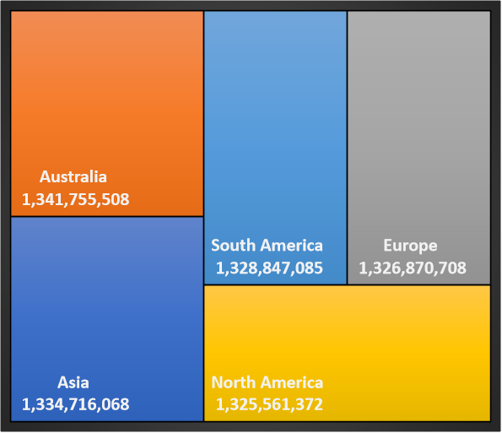
Data Visualization Road Accidents Across the Globe
Economic losses by region 🌍

Slide 26
Data Visualization Section of the Final Dashboard

Slide 27
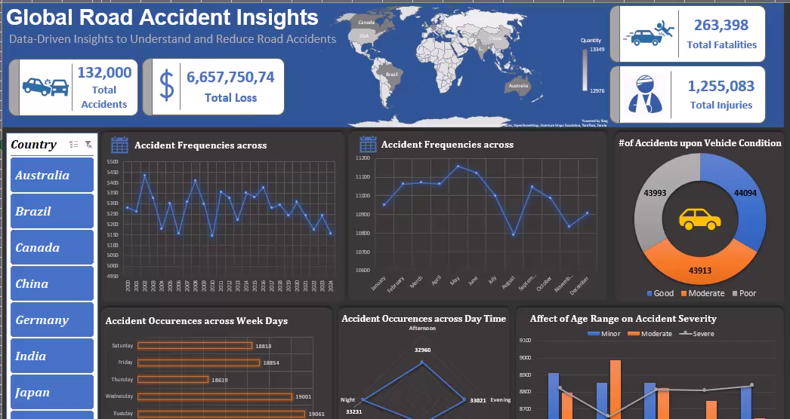
Data Visualization Full Dashboard

Slide 28



THANK YOU
Marwa Aboelenin
+201060664560
marwamostafa92@hotmail.com

